Slide 1
- ALANC
FLUTTER BASIC SHARING

Slide 2
What is Flutter?
A SDK for creating Mobile 2D app
Programing language Dart
What Flutter can do for you?
One language & One project
Support 2 different platform iOS & Android
Build & Publish

Slide 3
Alternatives
Alternative1
Alternative2
Alternative3
Build real native app
Build web app
Use Ionic or simulator solution
Use Java/ADT for Android
User may not use a Browser which can support the feature you need
Solve Browser compatibility issue
Use OC(Swift)/Cocoa touch for iOS
Performance is bad
You need to learn more languages/frameworks

Slide 4
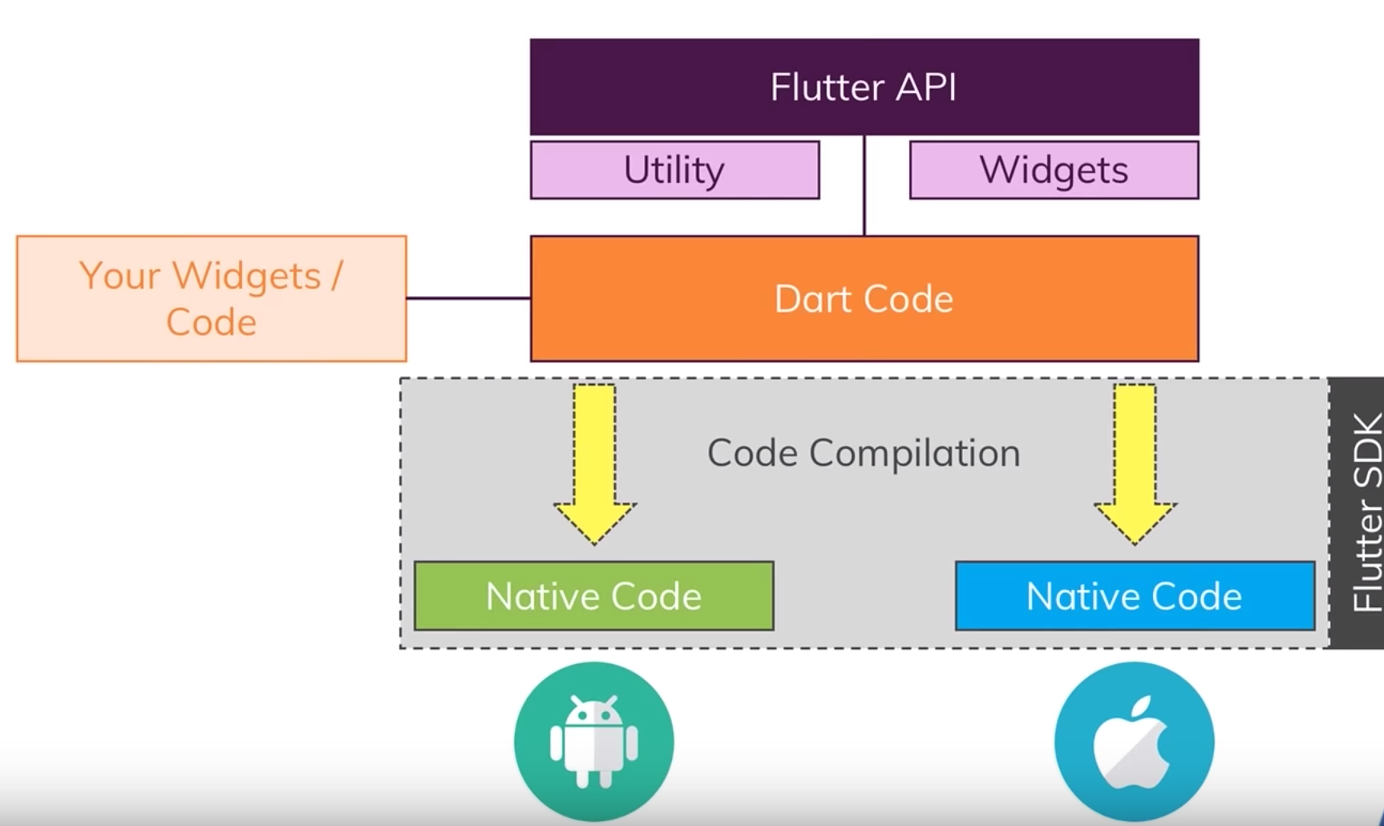
How does Flutter work?

Slide 5
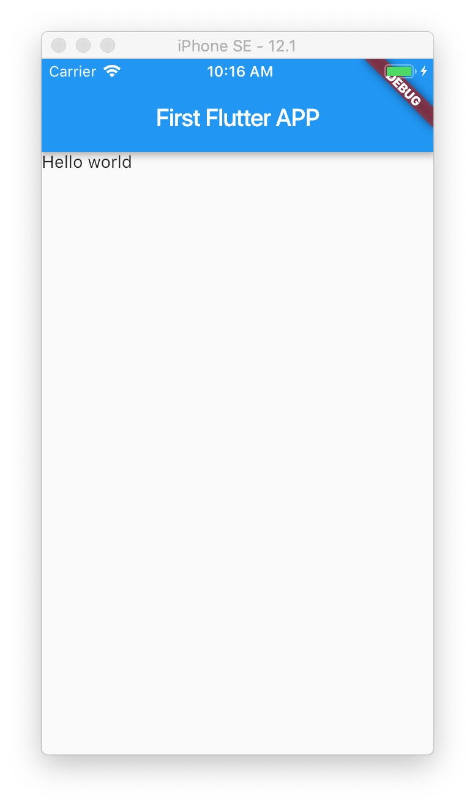



Slide 6
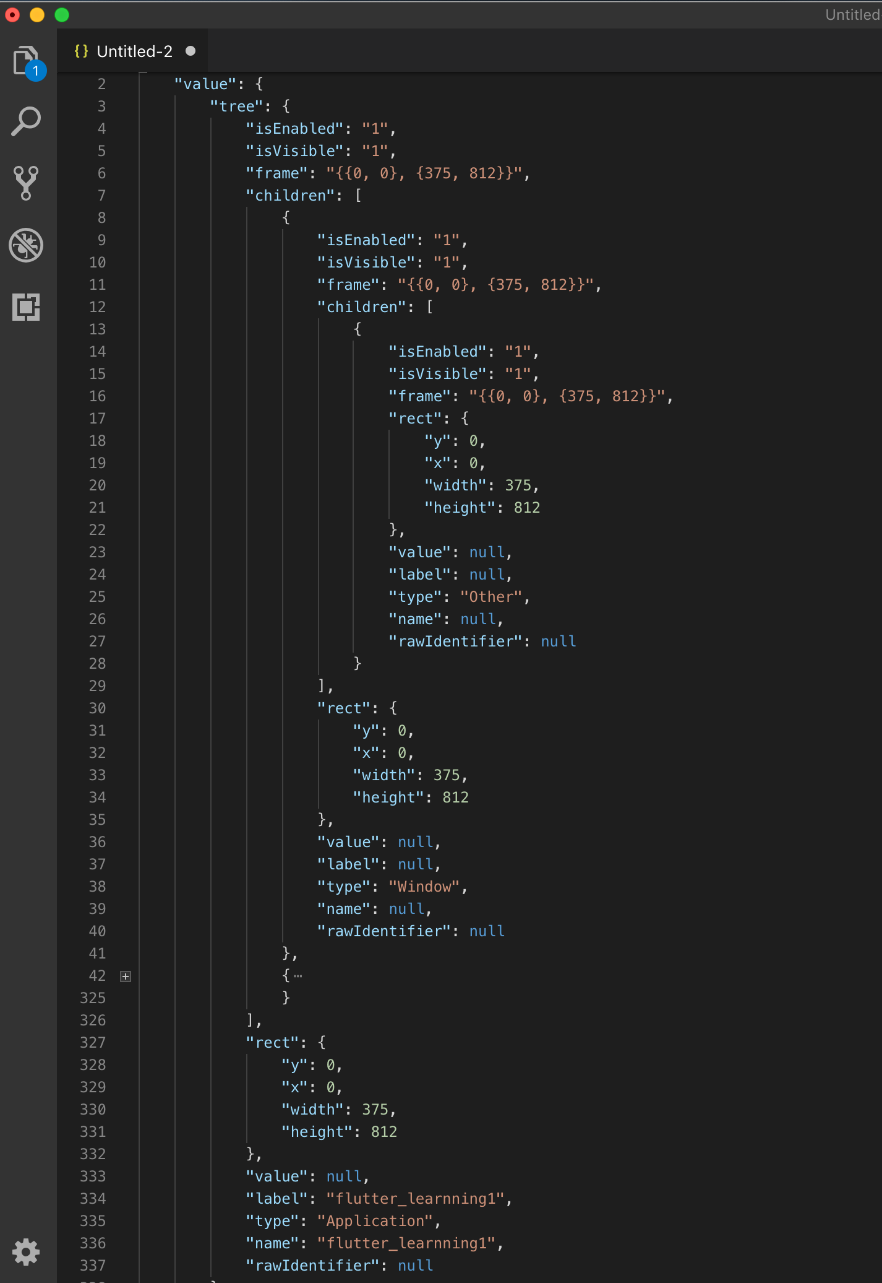

Slide 7
A quick and simple Introduction of the main features of Flutter
1 - Hello world project
2 - Basic layout component(Container & Column & Row & SizedBox)
3 - StatelessWidget & StatefulWidget
4 - Async task
5 - Outside dependency & Network
6 - Communication with Native platform code
7 - Save&Load data to/from disk

Slide 8
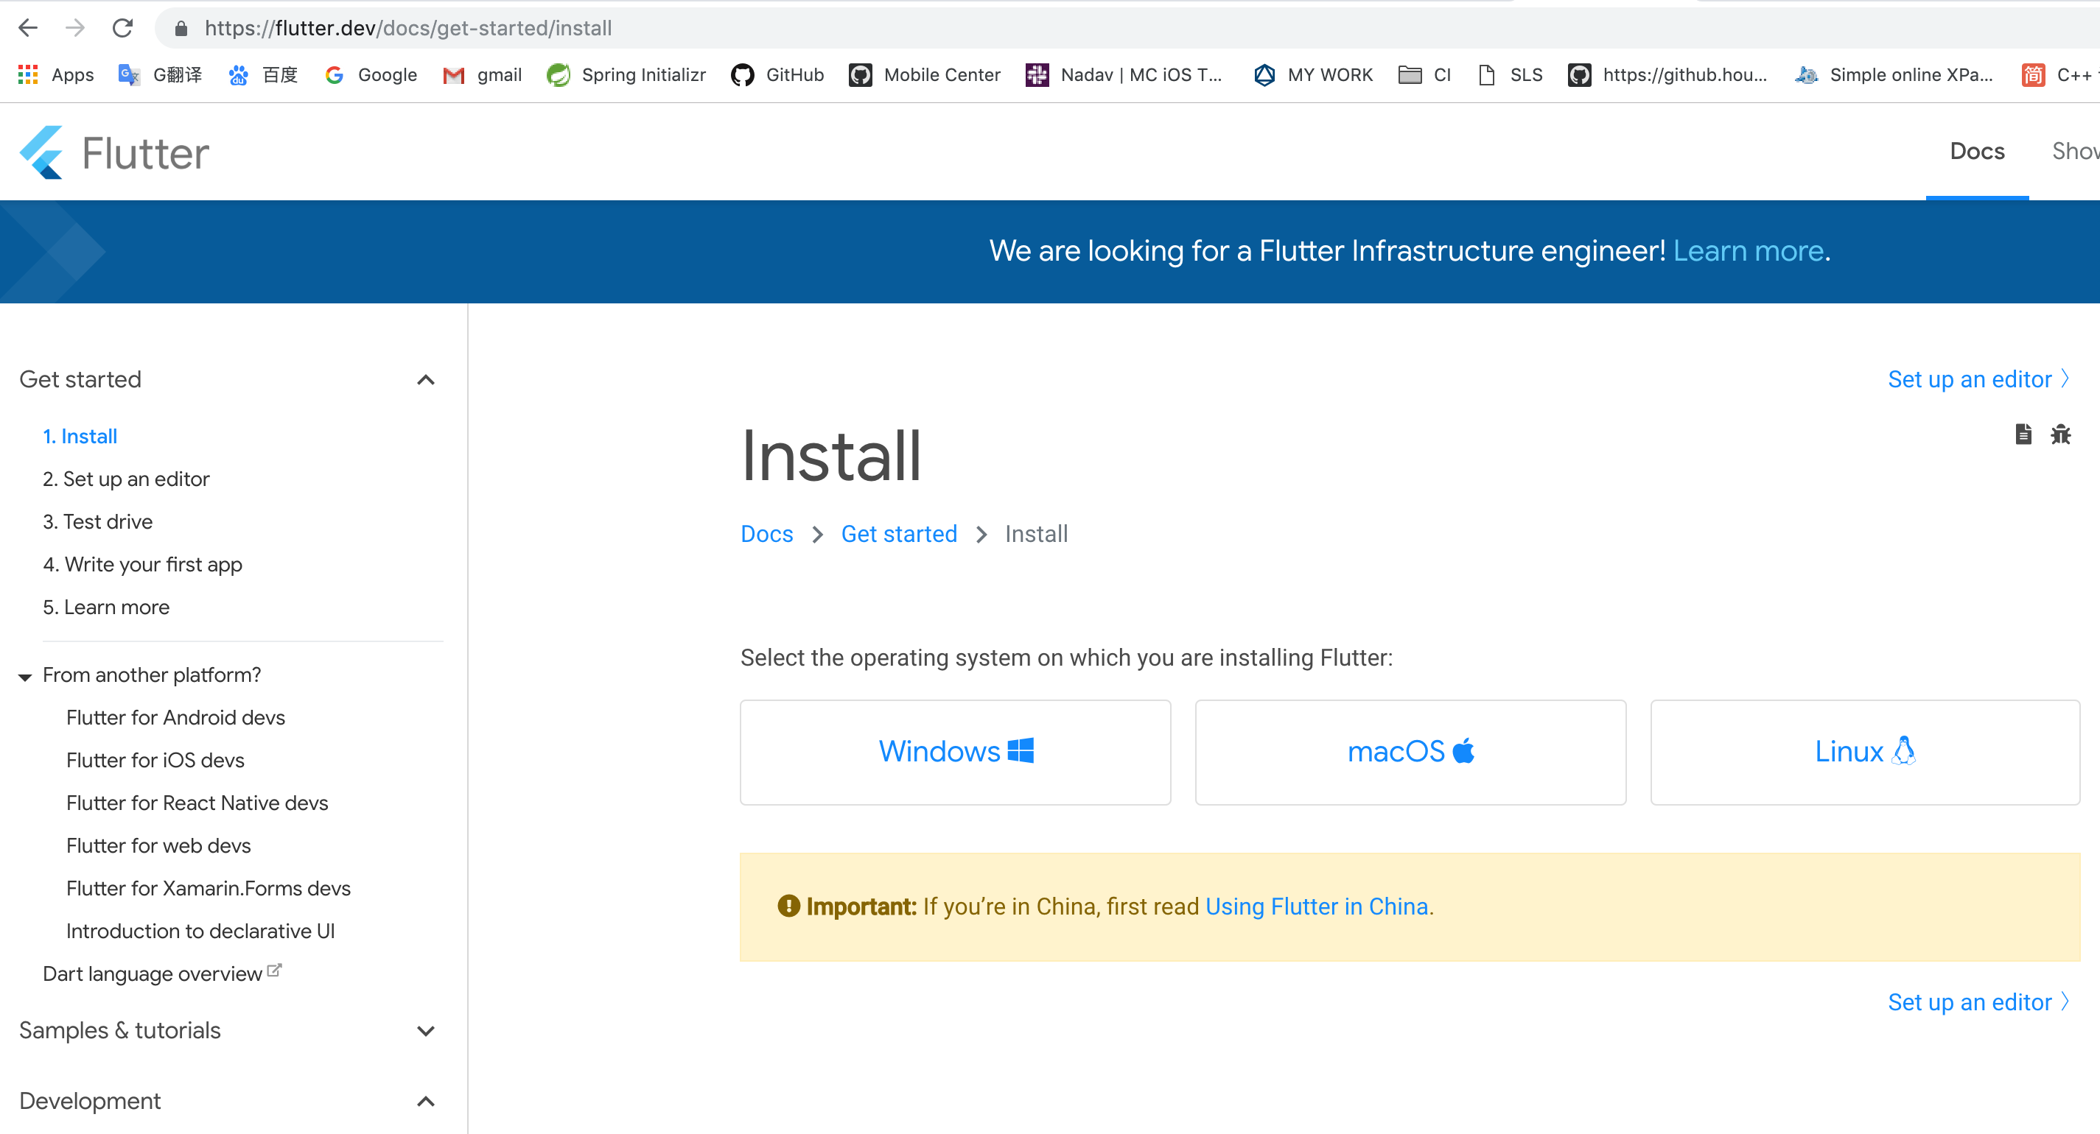
0 - Setup
https://flutter.dev/docs/get-started/install
Chinese version: https://flutterchina.club/get-started/install/

Slide 9
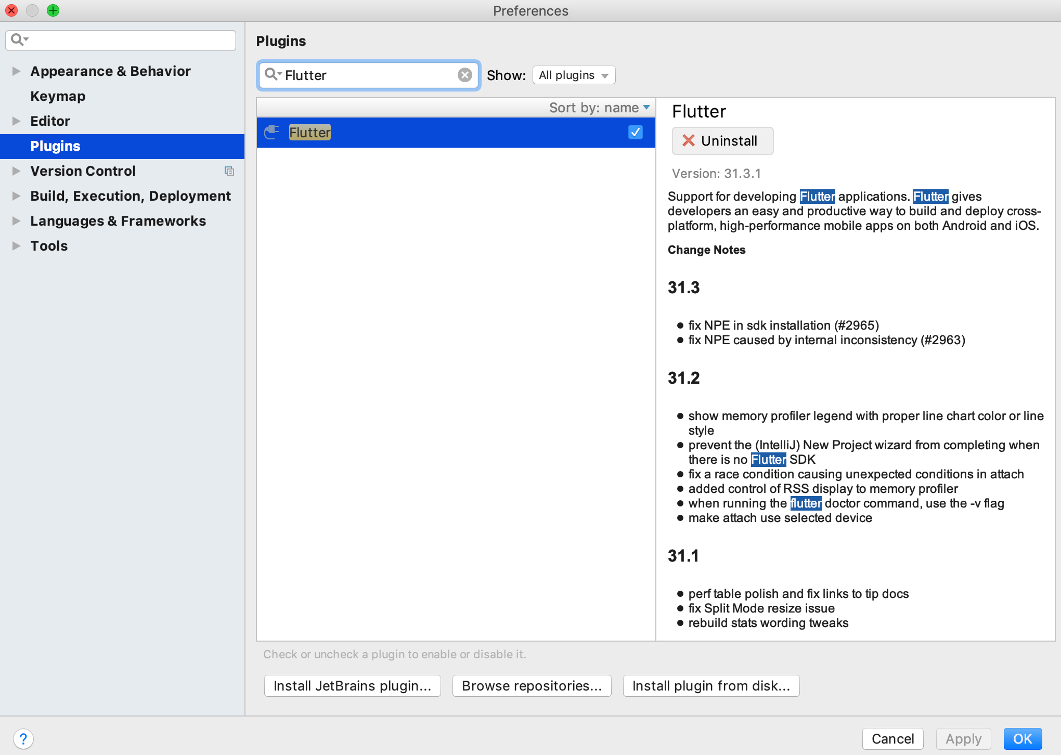
Goto: IntelliJ IDEA(AS) -> Preferences -> Plugins

Slide 10
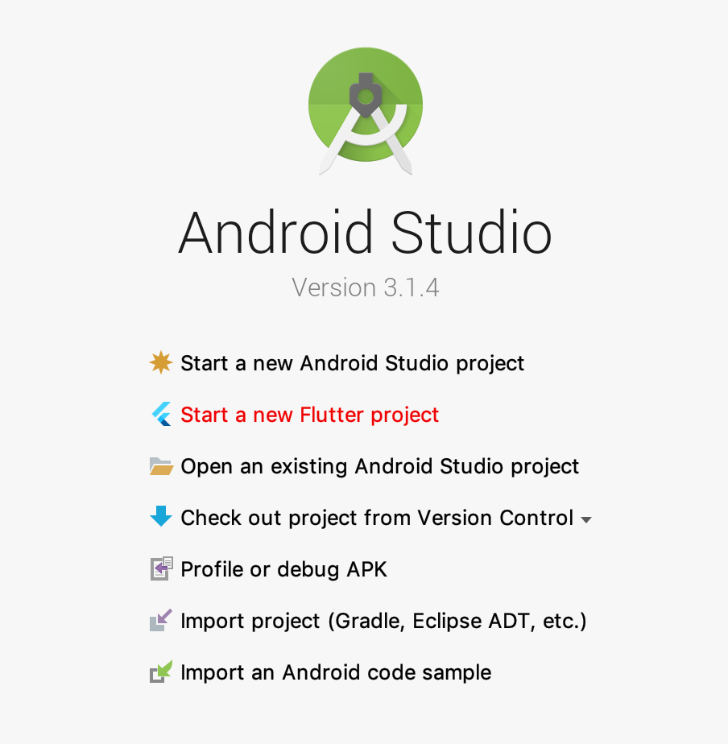
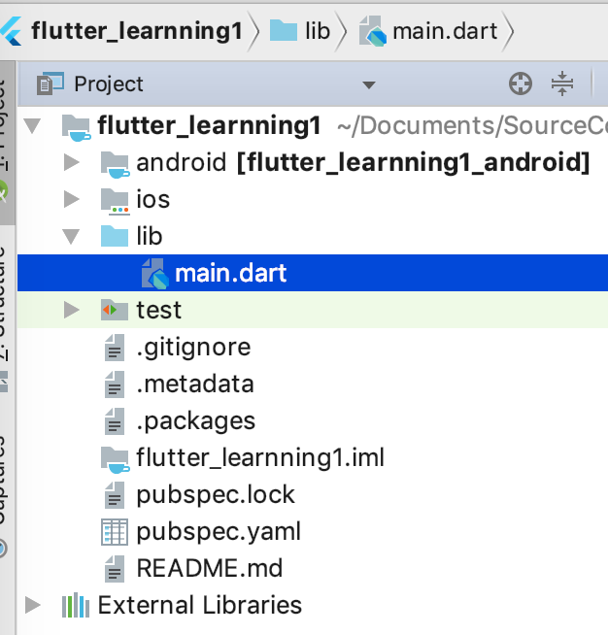
1 - Hello world project

Slide 11
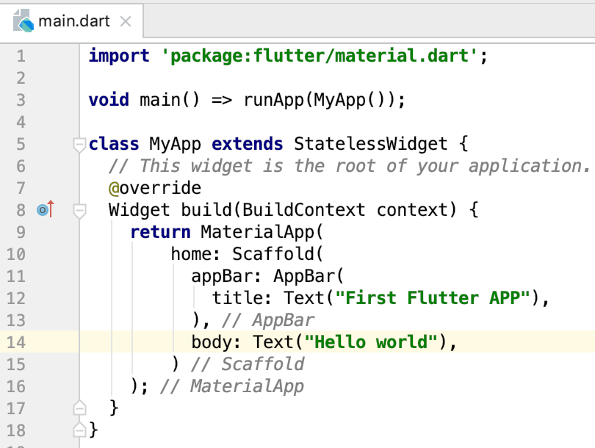
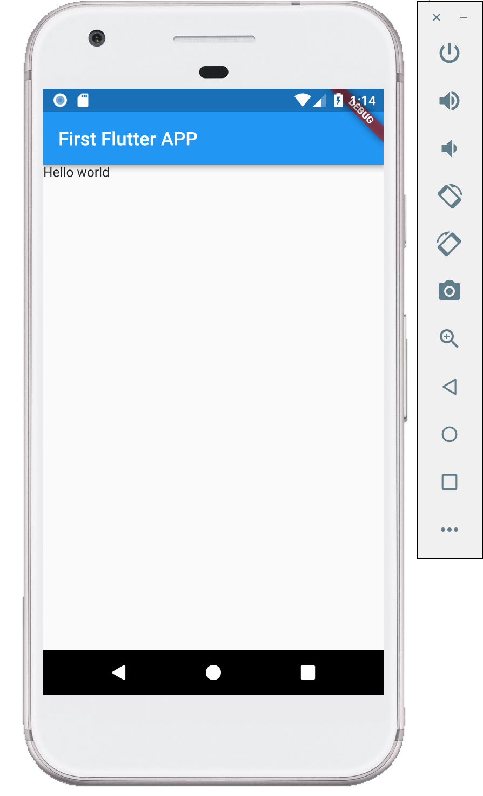
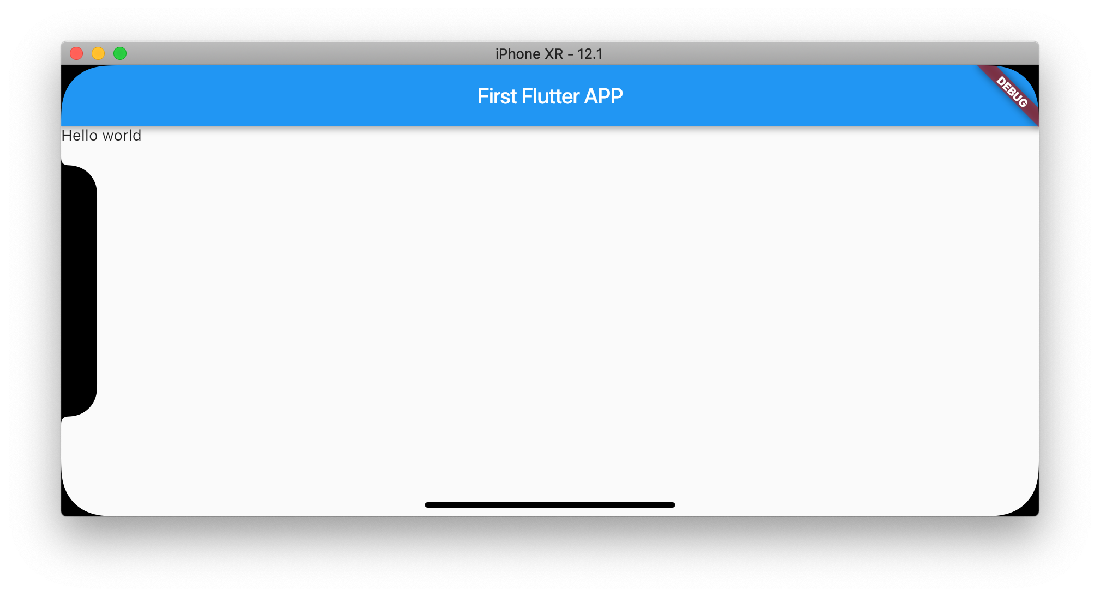

Slide 12
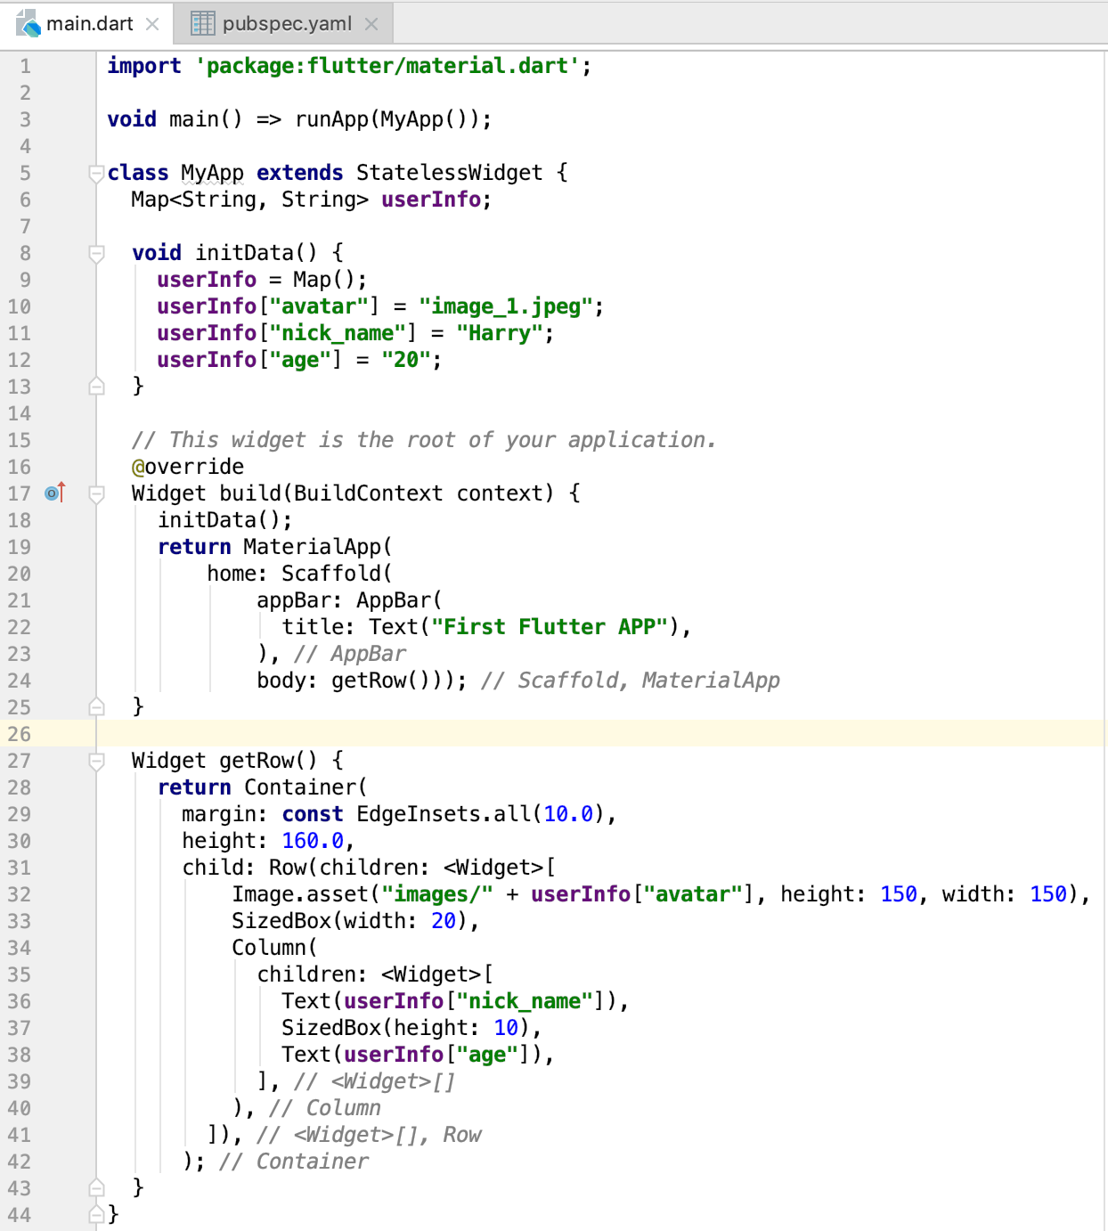
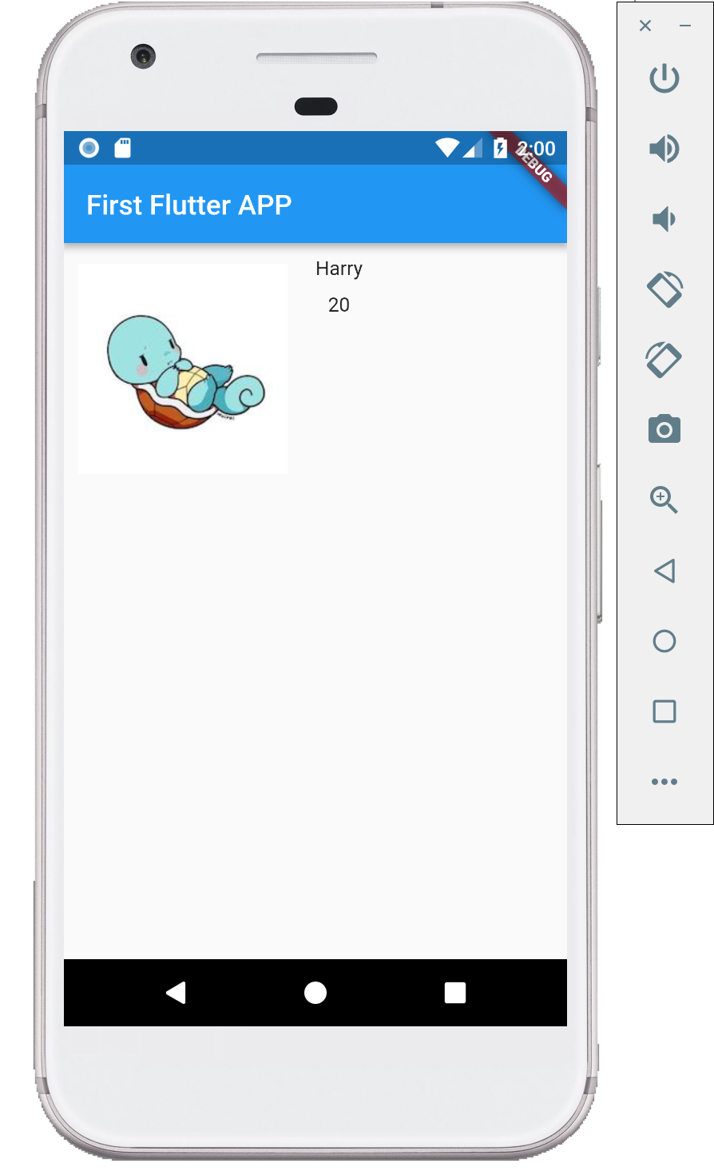
2 - Basic layout component(Container & Column & Row & SizedBox)

Slide 13
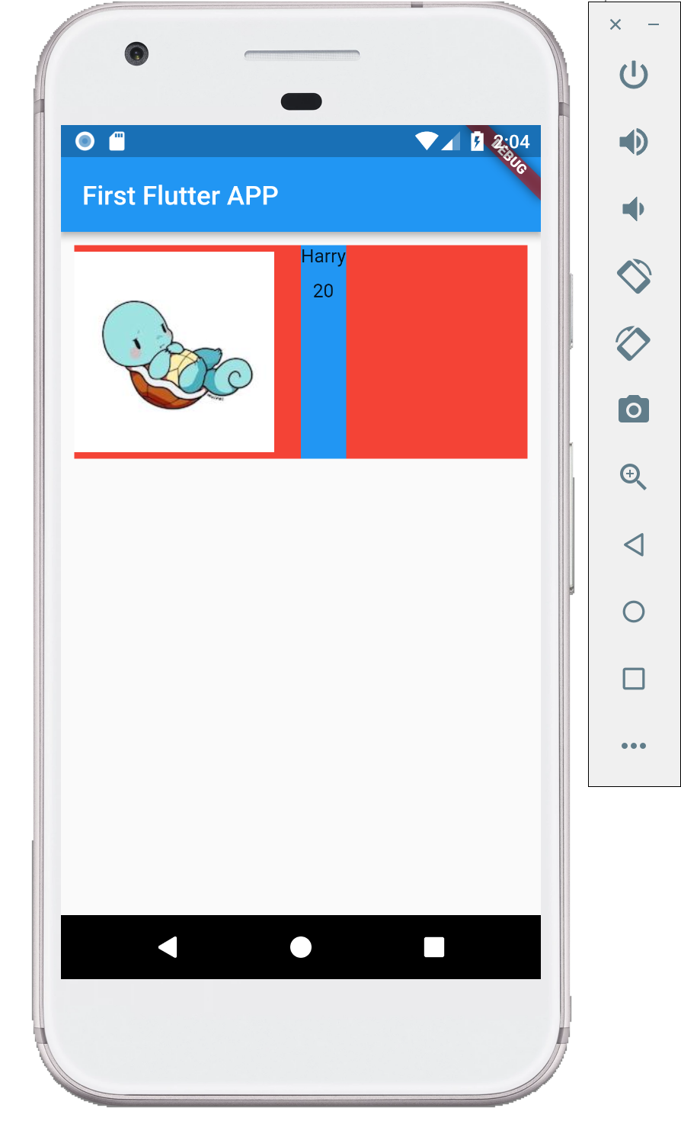
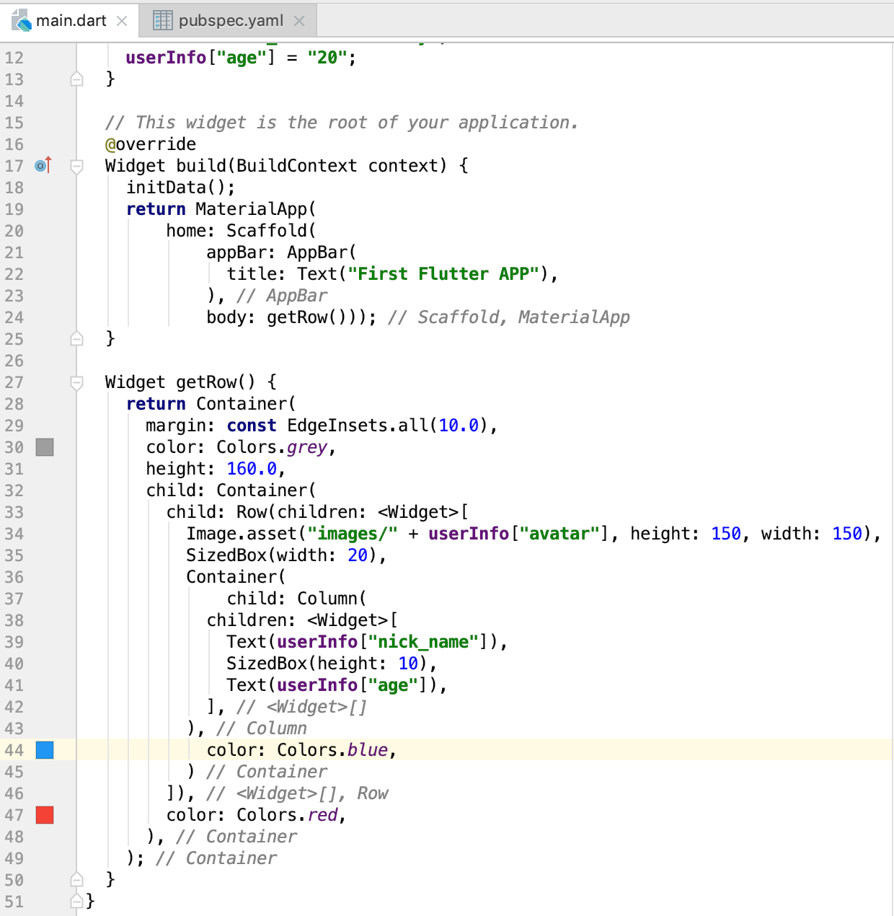

Slide 14
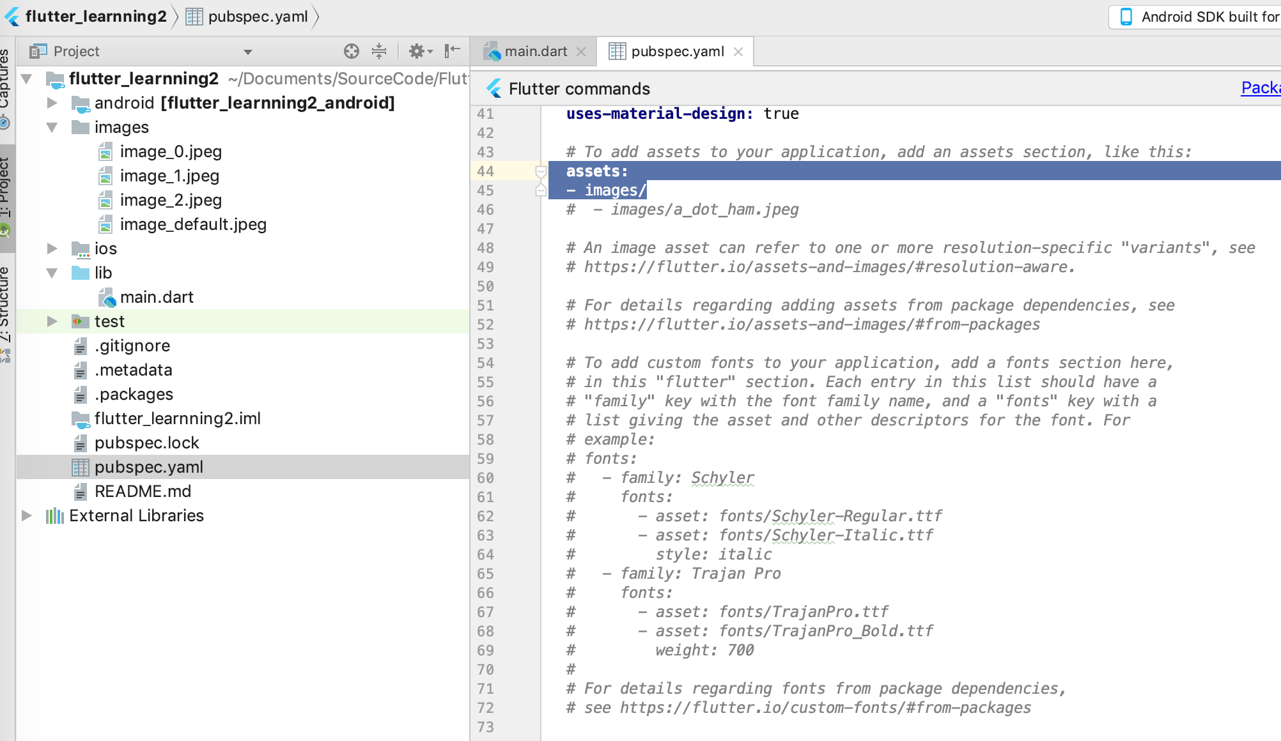

Slide 15
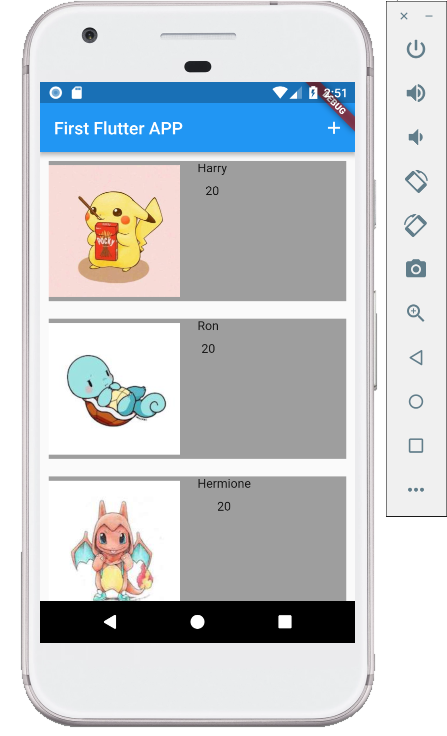
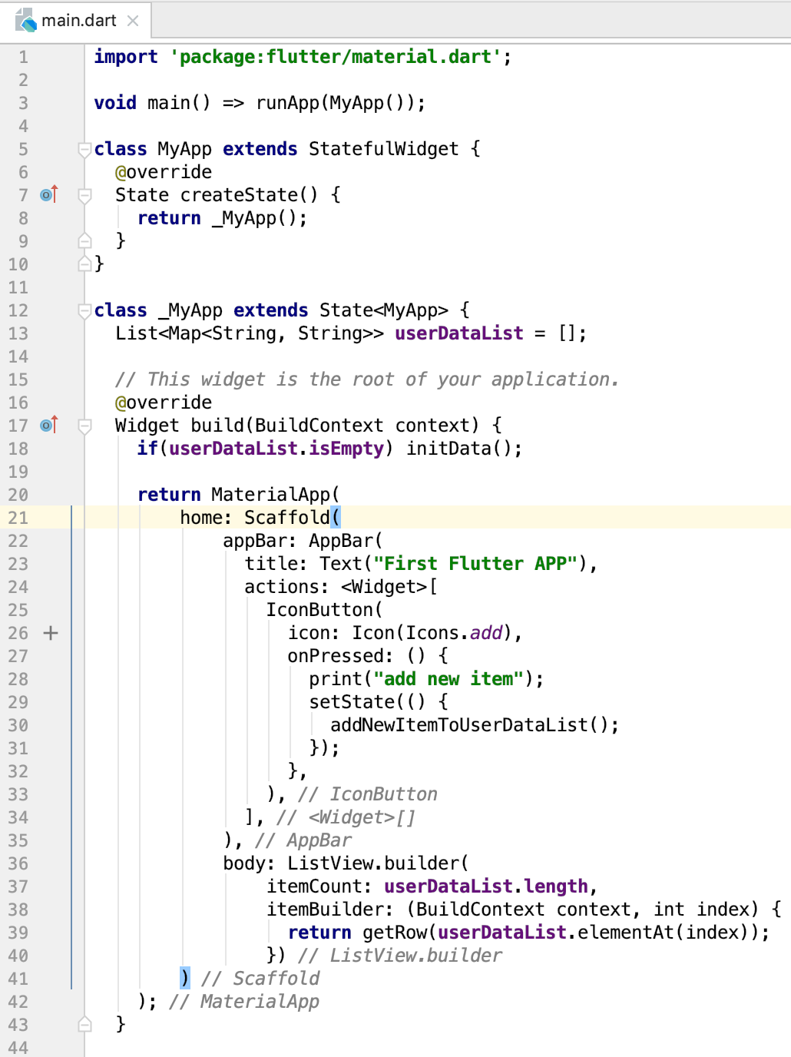
3 - StatelessWidget & StatefulWidget

Slide 16
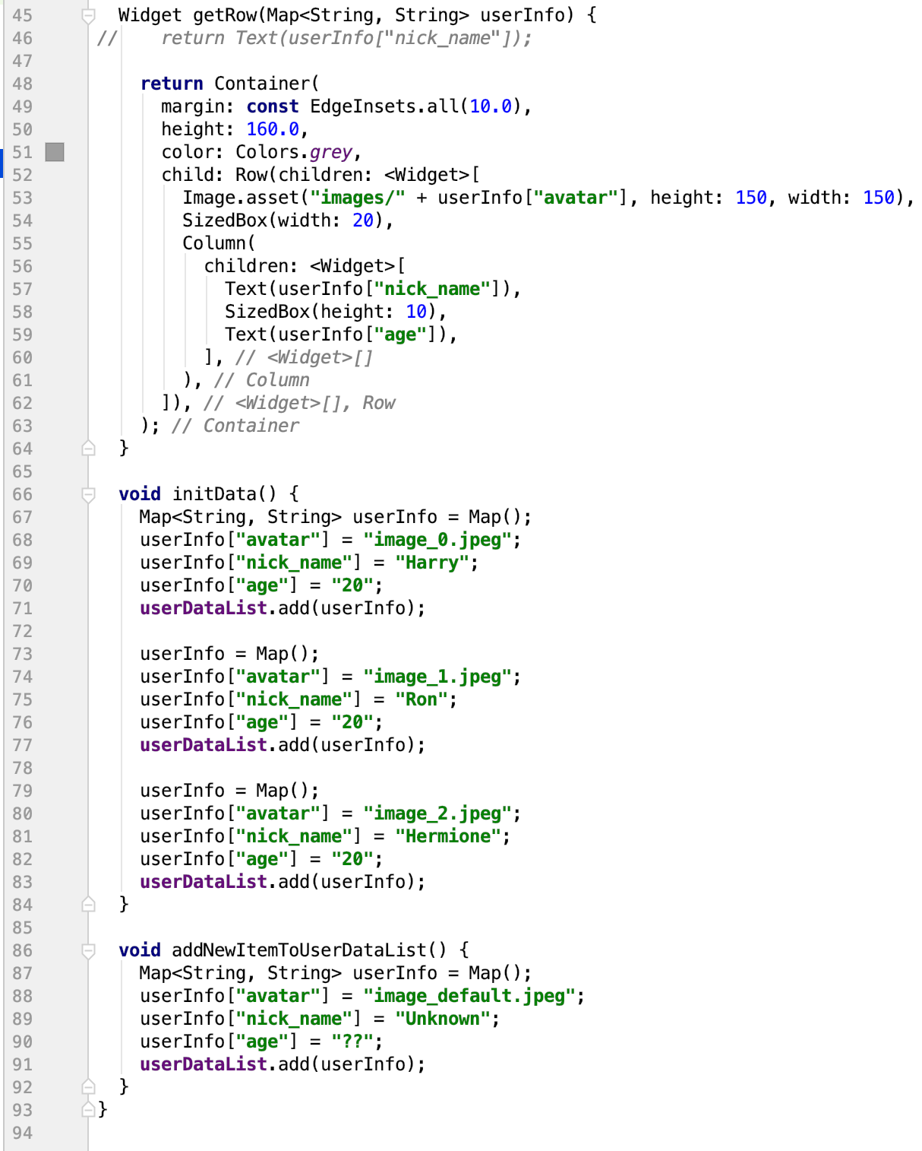
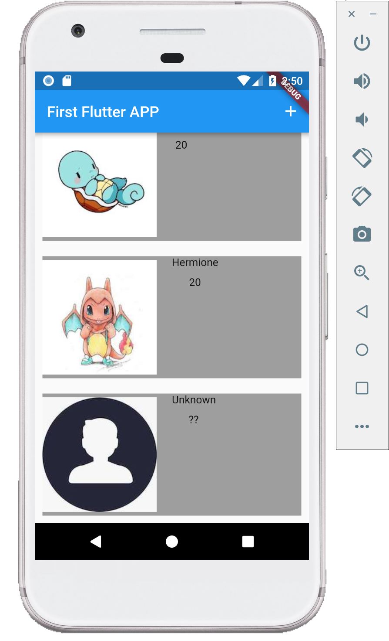

Slide 17
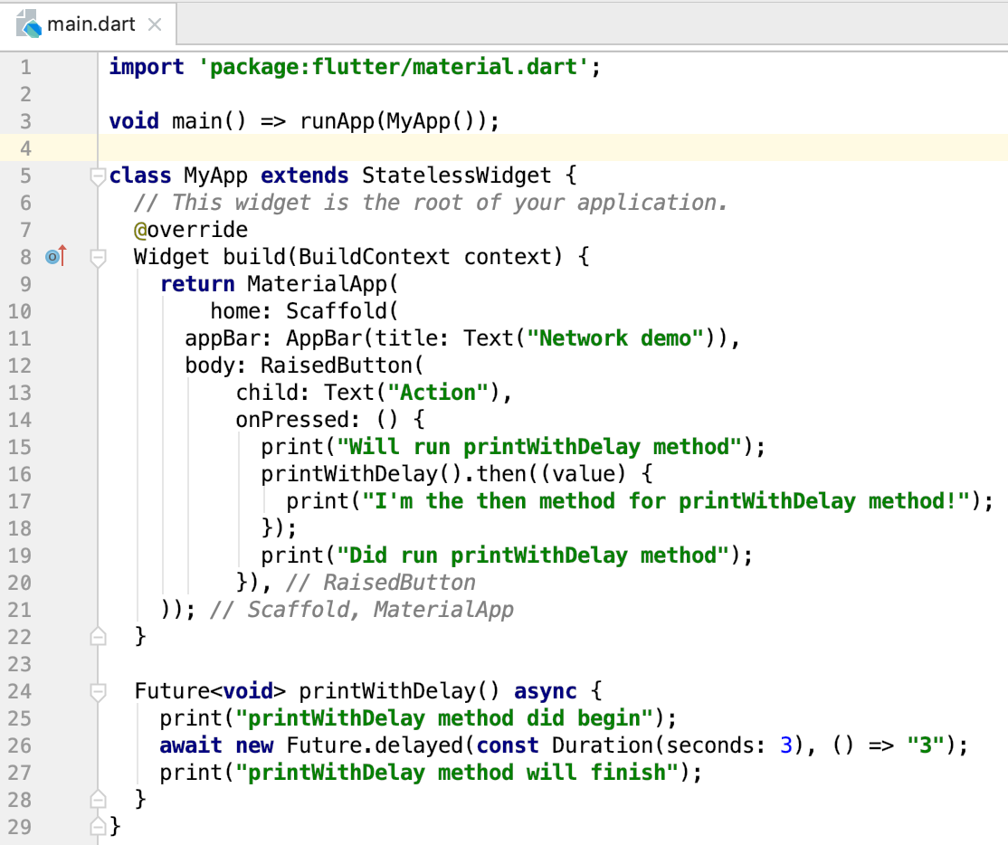

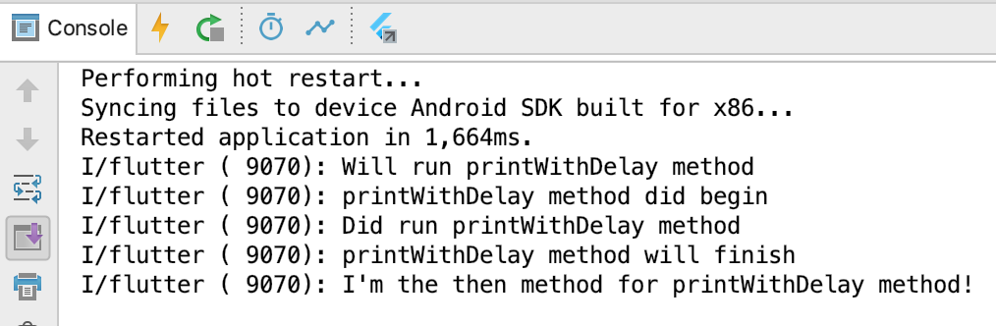
4 - Async task

Slide 18
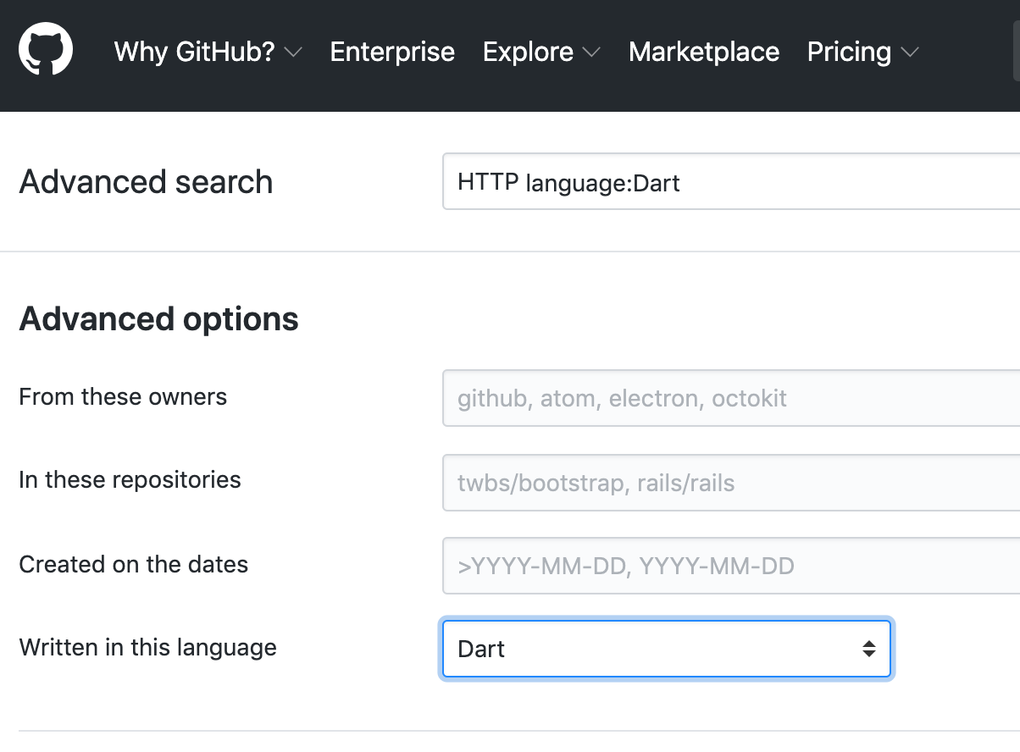
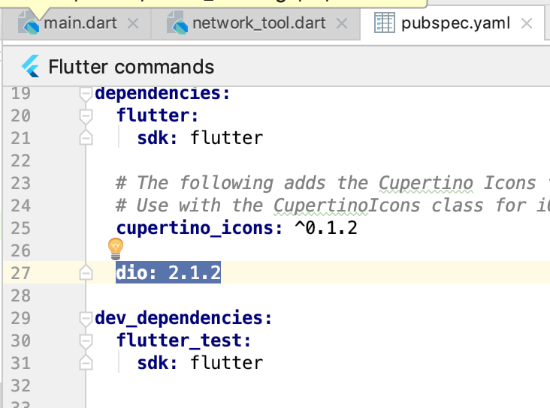
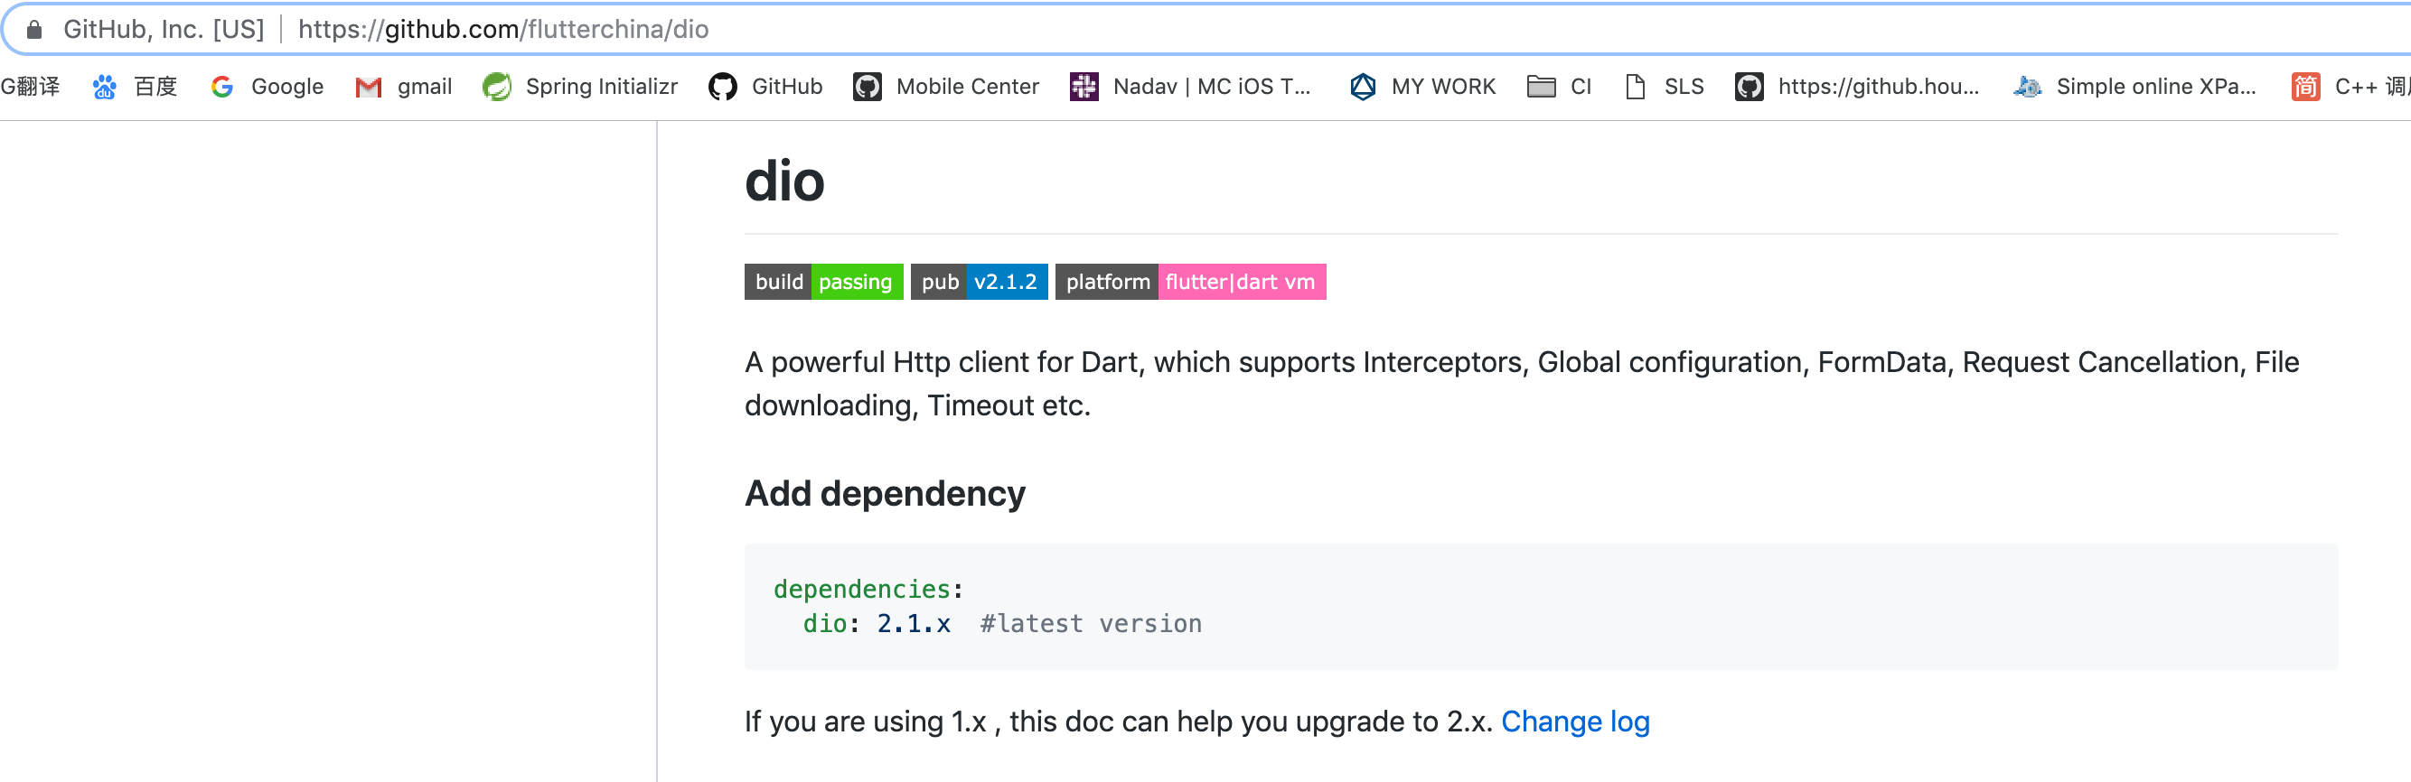
5 - Outside dependency & Network

Slide 19
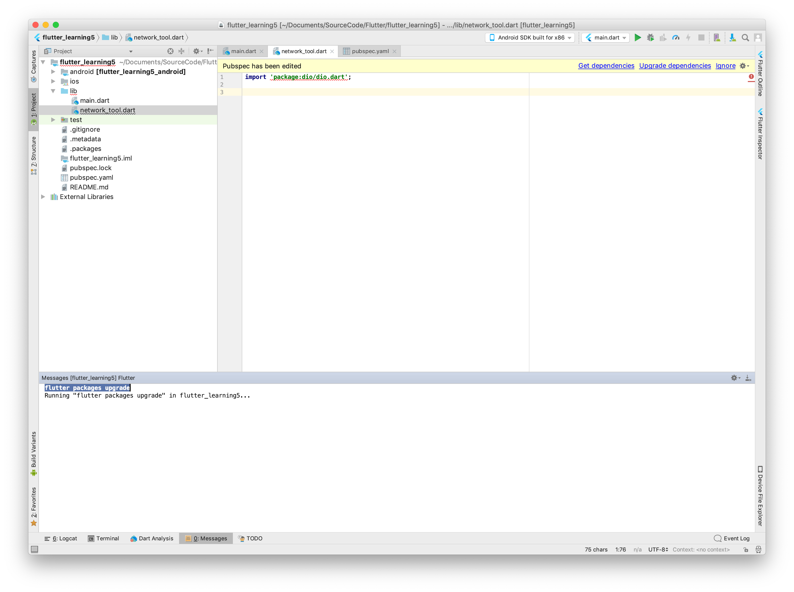

Slide 20

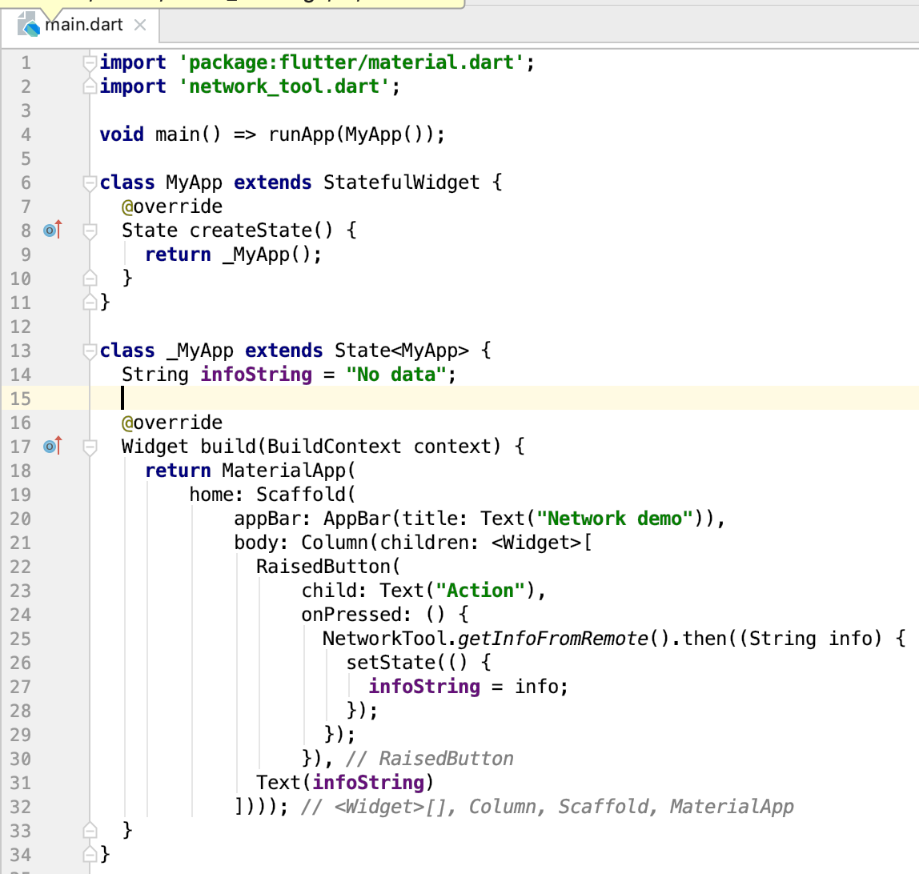

Slide 21
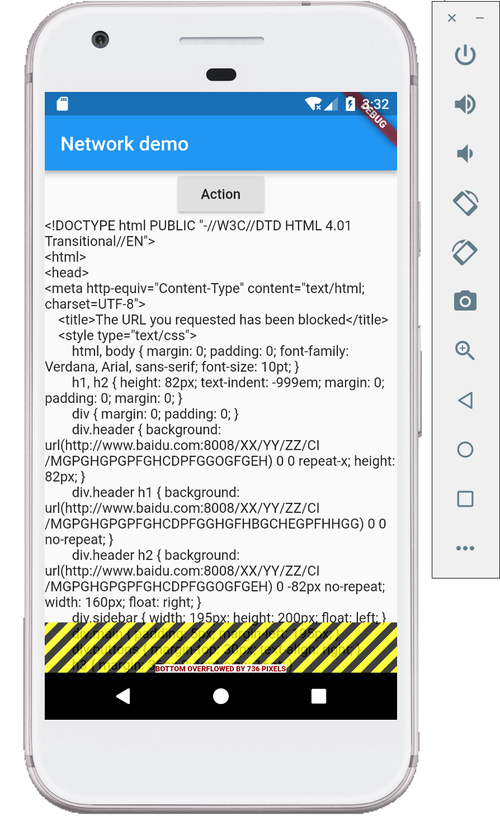
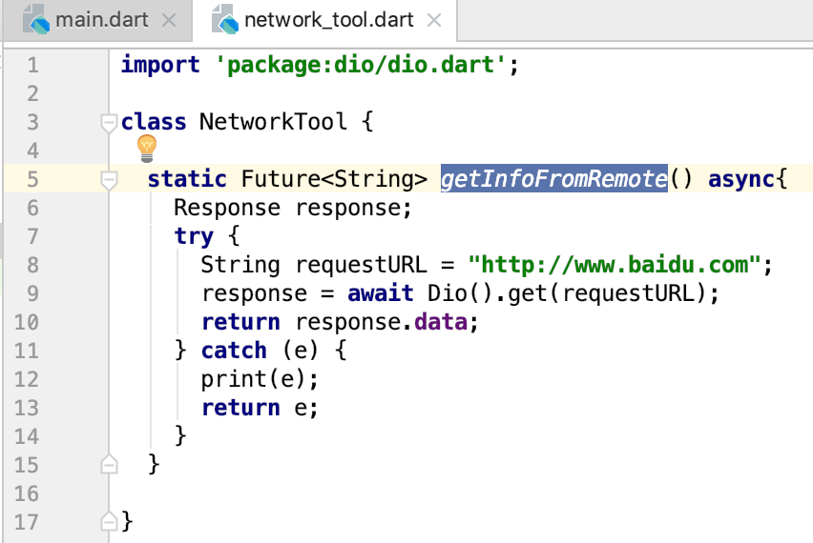

Slide 22

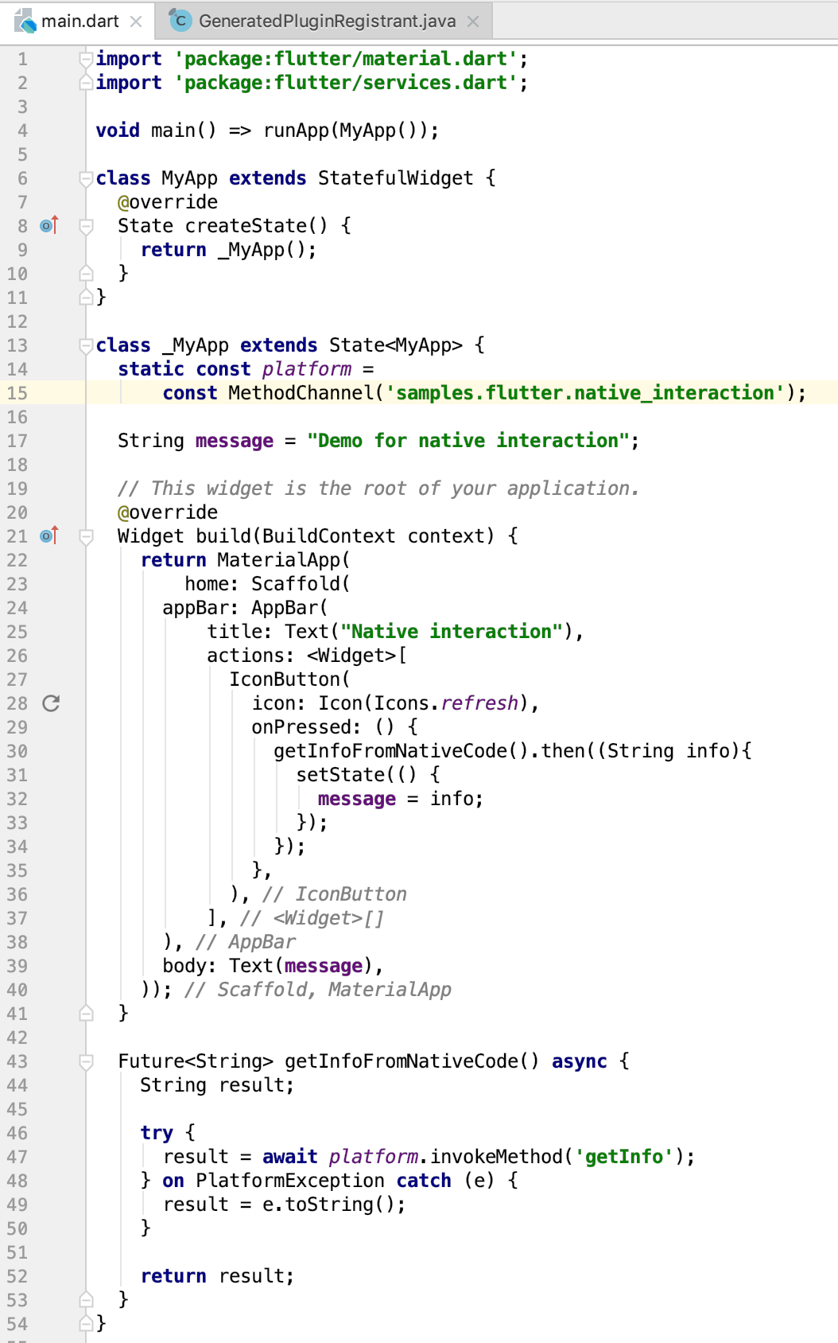
6 - Communication with Native platform code

Slide 23
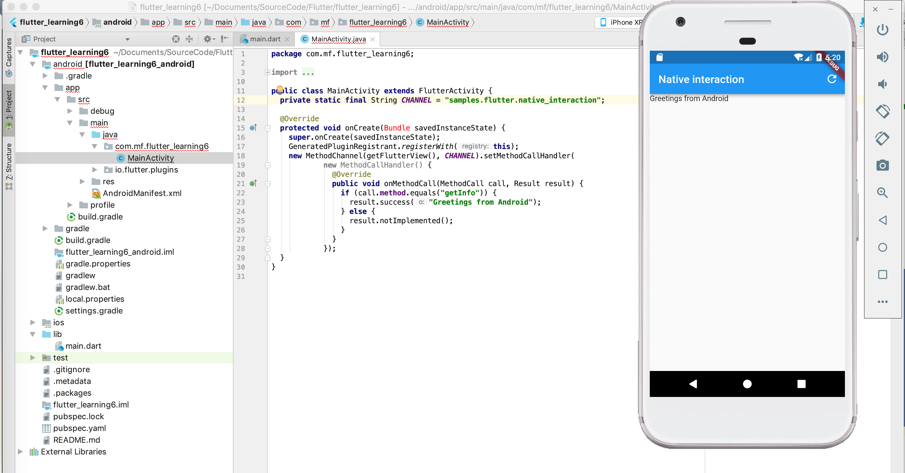

Slide 24
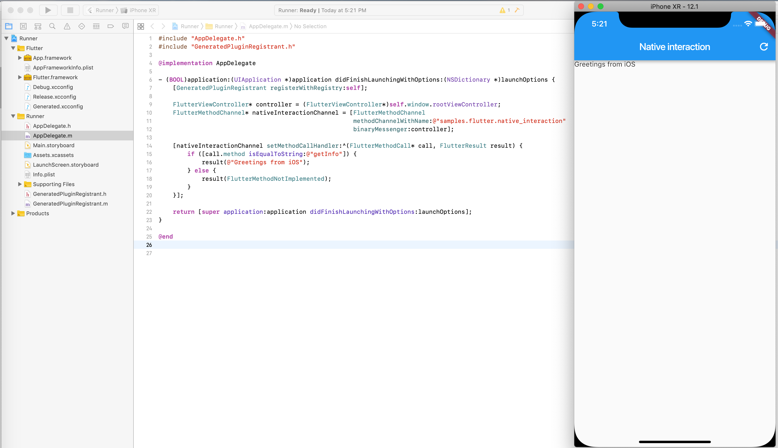

Slide 25
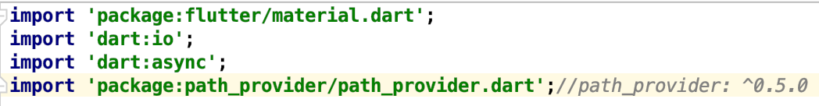
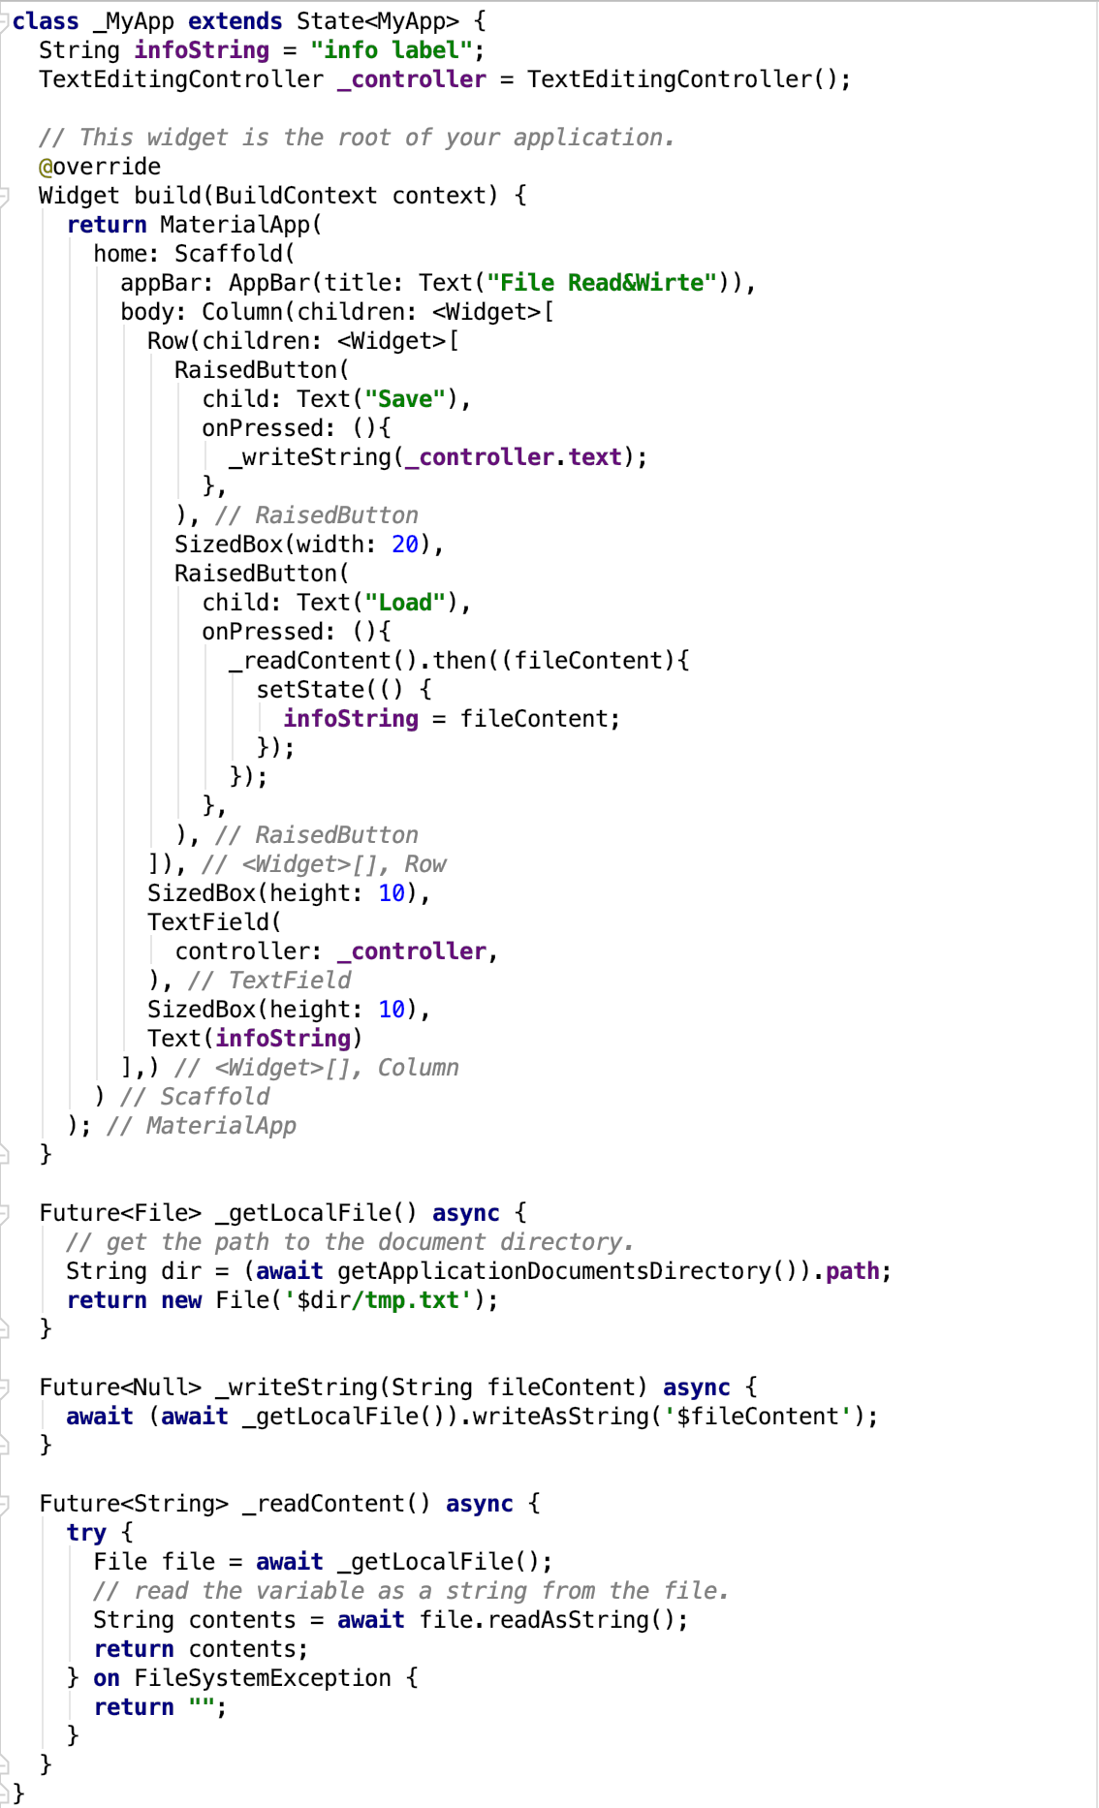
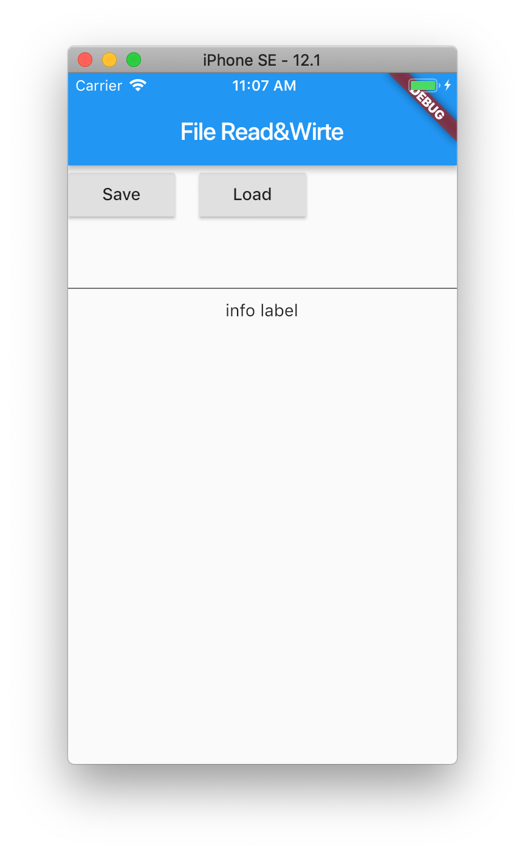
7 - Save&Load data to/from disk

Slide 26
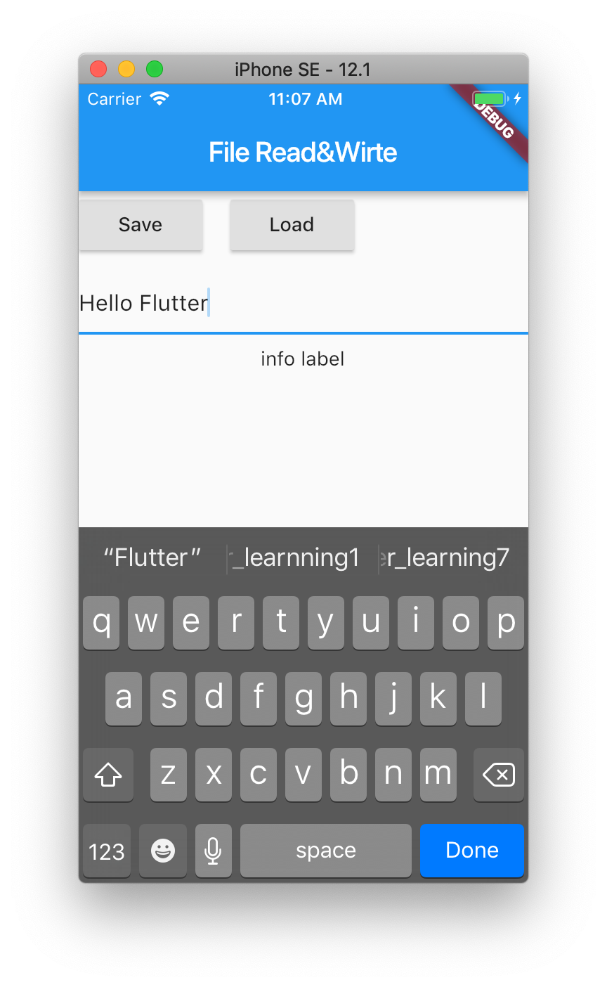


Slide 27
